Slide 1
Database Concepts Demystified
Joseph Rudolf
API R 2024
Notes:
Welcome to our first session of the workshop, Database Concepts Demystified!

Slide 2
Goals and Objectives
Goal:
Get acquainted with the fundamentals of databases including relevant terms and definitions and orient to the environment used in today’s workshop.
Objectives:
Define database systems
List advantages of working with databases
Differentiate fact and dimension tables
Log into Posit Cloud, create a project from a GitHub repository and install packages
Orient to data relevant for workshop
List common clauses in SQL statements
Notes:
In this session we are going to get acquainted with the fundamentals of databases. We will define some important terms and orient to R environment we will be using for today’s workshop.
The objectives include the specific things we hope you will be able to do after this session.

Slide 3
Definitions and Terms
Notes:
We will start by discussing a few important database definition and terms.

Slide 4
What are Database Systems?
Database: the data, often a series of related tables
+
Database Management System (DBMS): the software for interacting with the database, including writing or extracting data
Notes:
Database Systems consist of a database (the data) and a Database Management System (the software).
You may hear this combination referred to simply as a “Database”.
Database systems are all around us in healthcare (electronic health record, laboratory information system, billing system, etc.).

Slide 5
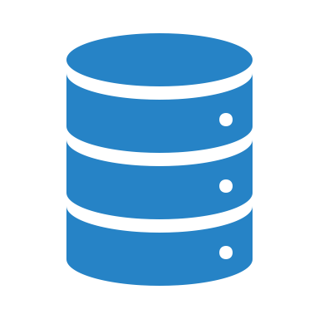
Database System Benefits
Rules for maintaining data integrity
Administrative controls for data access
Capable of storing large amounts of data
Efficient data storage
Notes:
Database Systems have many benefits over working with discrete data files (i.e. excel or CSV files) for operations and analytics.
These include but are not limited to:
-Rules for maintaining data integrity
-Controls for data access
-Capability for store large amounts of data, and efficiently!
When you are dealing with more data than you can load into your system memory, it’s time for a database system!

Slide 6

Relational Databases
Proposed by Edgar F. Codd at IBM in 1970
Dominant database model to this day
Data organized into entities (tables) with records (rows) and attributes (columns)
Tables normalized to reduce redundancy of stored data
Tables linked to other tables by common keys (shared attributes)
Notes:
The most common type of database system (the relational database) was proposed by E.F. Codd at IBM in 1970.
Relational databases have data that is organized into related tables with rows and columns (think dataframe in R).
Tables are normalized (process of organizing data in a database) to reduce the redundancy of stored data (and the associated overhead of maintaining the same data in multiple places)
Tables can be linked (a process called joining) by their shared attributes. We will discuss joining in detail in the third session (Joining Forces: Data Merging Techniques in R).
There are non-relational databases too! RedCap is one such non-relational system and we will have an opportunity to learn about it in the fourth session (Getting Your Feet Wet with Clinical Research Data with REDCap and R).

Slide 7
Table Types
Fact
Dimension
Contains the transactional/run the business type data
Often the table of interest when performing analyses
May be longer
“How many tests did we run in 2024”
Contains the descriptive data
Often required to decode data in fact tables
May be wider
“What are the tests available on the test menu”
HINT: If each row needs a time stamp to be meaningful, it is probably a fact table.
Notes:
Table types come in two flavors: Fact and Dimension.
Fact tables contain the transactional data. These tables tend to be the center of attention when performing analyses. They tend to be long tables with many rows. For example if you were trying to answer a question like “How many tests did we run in 2024”, the answer would probably be found in a fact table.
Dimension tables on the other hand, contain the descriptive data. They help give “dimension” to the fact tables and are often required to decode the data in fact tables. The may be wider tables (because they have lots of attributes for descriptions). If you were trying to answers a question like what are all the “tests available on the test menu”, a dimension table is likely to be your friend.
A rule of thumb for differentiating a fact table from a dimension table focuses on the role of a timestamp. If the presence of a time stamp (i.e. date/time) is required for each row to have meaning, you are likely dealing with a fact table. And if not, it is probably a dimension table.

Slide 8
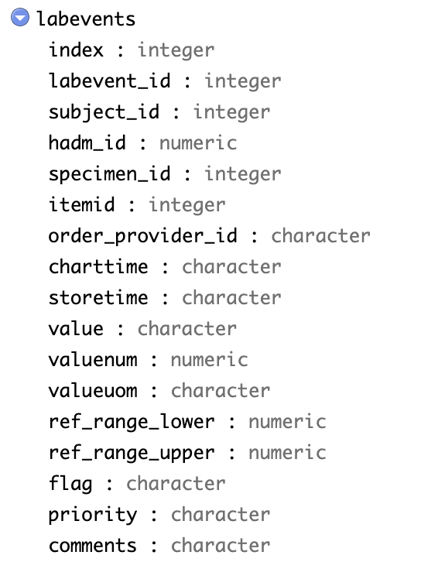
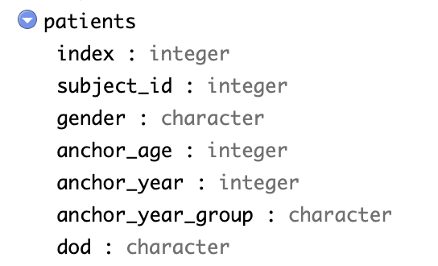
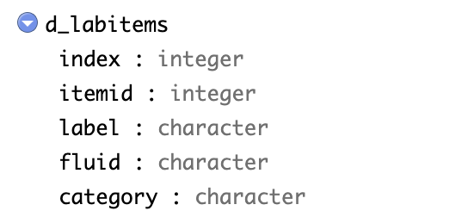
Tables Can Be Joined to Bring Facts and Dimensions Together
Notes:
A common reason for joining is to bring fact and dimension table data together.
Here we have three tables linked by their common keys.

Slide 9
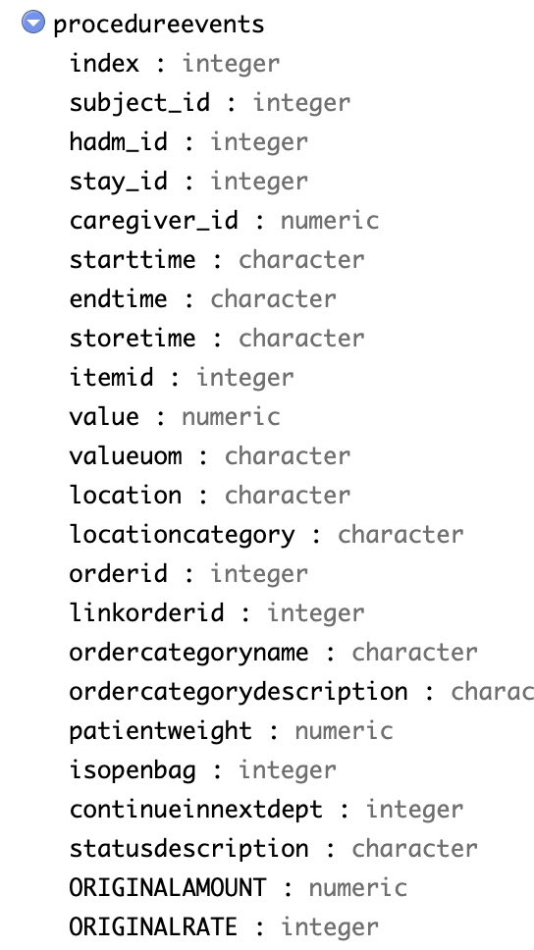
Your Turn #1
Which key would allow these tables to be joined?
Notes:
Which key would allow these tables to be joined? Answer: subject_id
[Bonus: Why not the index? Answer: The index is a sequential identifier for table rows (0,1,2,3,4) but does not have a relationship to the content of the row. Joining the index of two tables together would not reference the same data between tables.]

Slide 10
Logging Into the R Environment
Notes:
Now that we have covered some of the important term and definitions related to database systems, let’s take a few minutes to log into the R Environment we will use for today’s programming exercises.

Slide 11

RStudio: On the Web and In Your Home
Posit (RStudio) Cloud
Hosted on a server
(in the cloud)
RStudio Desktop
Installed locally on your computer
Note: Posit Cloud only for this course. Do not upload protected health information to the cloud!
Notes:
RStudio can be installed in multiple ways (locally on your computer or in the could).
For today’s workshop we are going to use a cloud environment hosted by the company (Posit) that make the RStudio software.
We will create a Posit Cloud project from a GitHub repository. This will be attached to your personal Posit Cloud login and will be available for you after today’s course if you wish to revisit the content.
As a reminder, do not upload protected health information to this cloud.

Slide 12
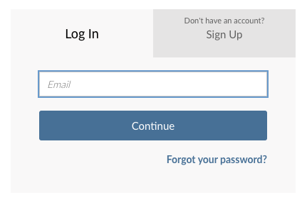
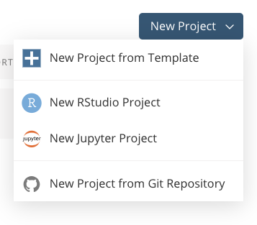
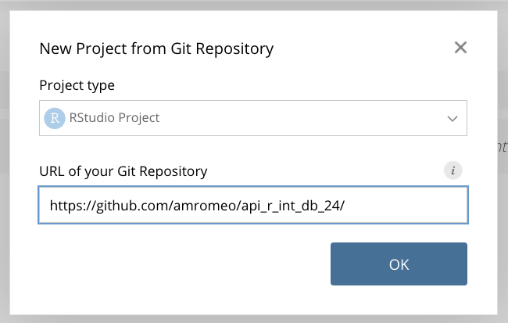
Your Turn #2
Go to https://posit.cloud
1 – Log In
3 – Enter Repository
2 – Create New from Git
Notes:
Navigate your browser to https://posit.cloud and log in with your personal Posit Cloud login (or create one now if needed).
In the upper right hand corner (after logging in), select ”New Project” and then “New Project from Git Repository” from the dropdown.
Enter the URL for the repository: https://github.com/amromeo/api_r_int_db_24 and select okay.
bit.ly/APIR24
https://github.com/amromeo/api_r_int_db_24

Slide 13
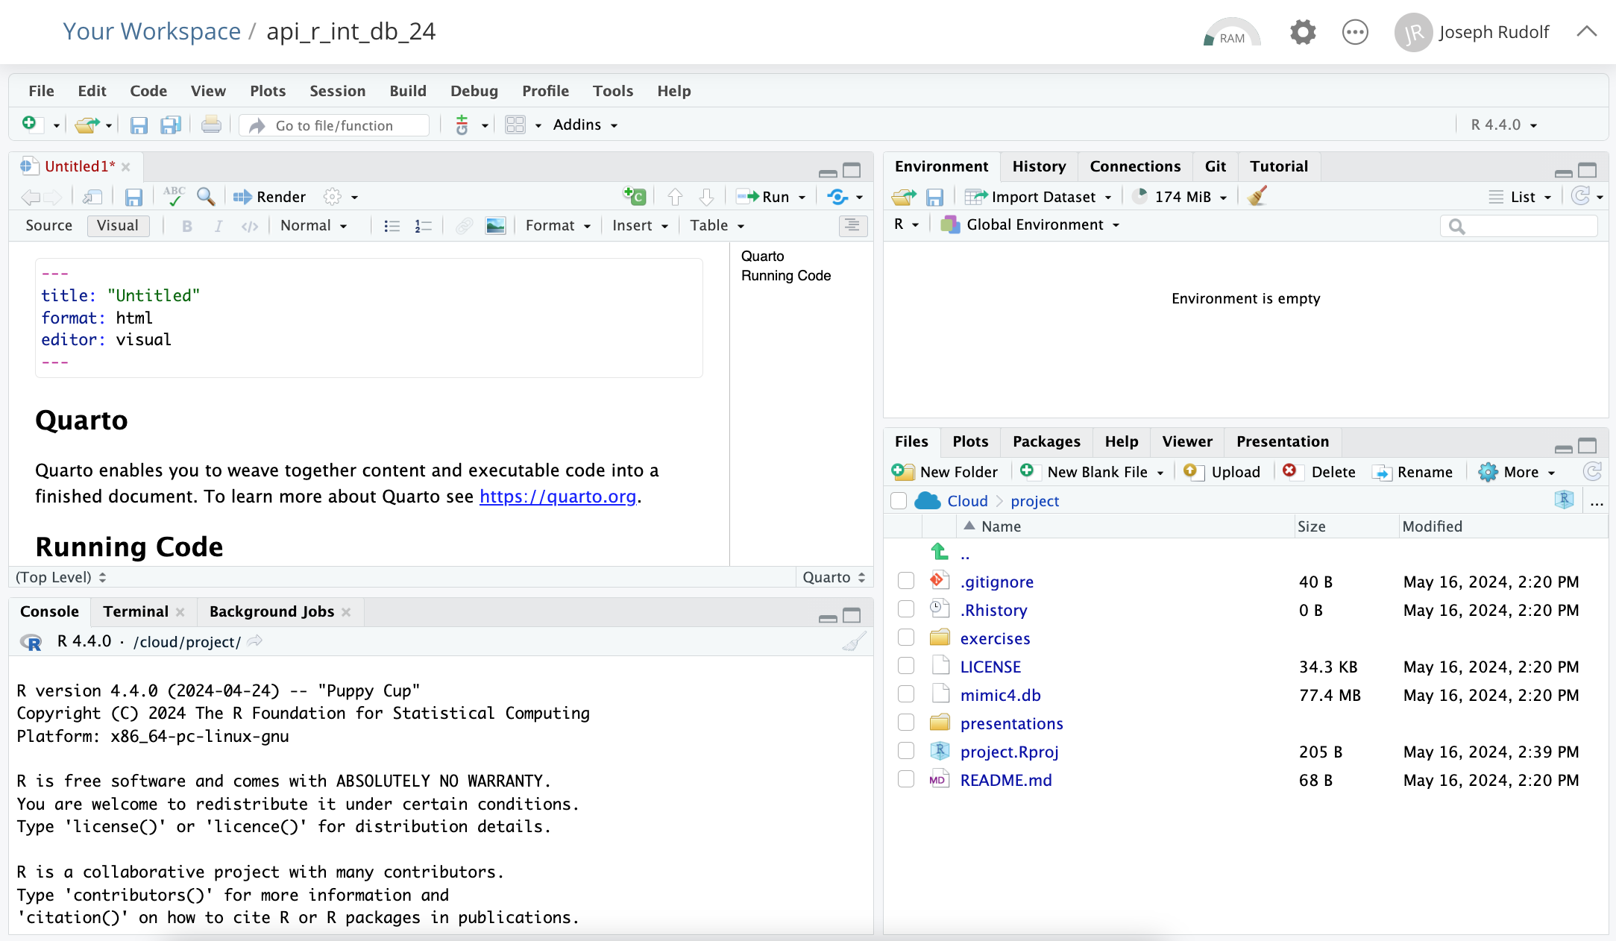
ENVIRONMENT
EDITOR
CONSOLE
MISC
Notes:
Here’s what the RStudio window looks like after you have created the project from the GitHub repository.
On the top left is the editor. This is where you enter code.
On the top right is the Environment. The environment allows you to look at the data that’s loaded into R. Interacting with data in the environment tab provides some of the functionality you may be familiar with from working in Excel.
The Console is on the bottom left. You can use the console quickly run an individual R command. We won’t use the console in this course.
The pane we have labeled “MISC” has a few of tabs. The most important one for today is the “Files” tab which shows the files we’ll be using for the course.

Slide 14
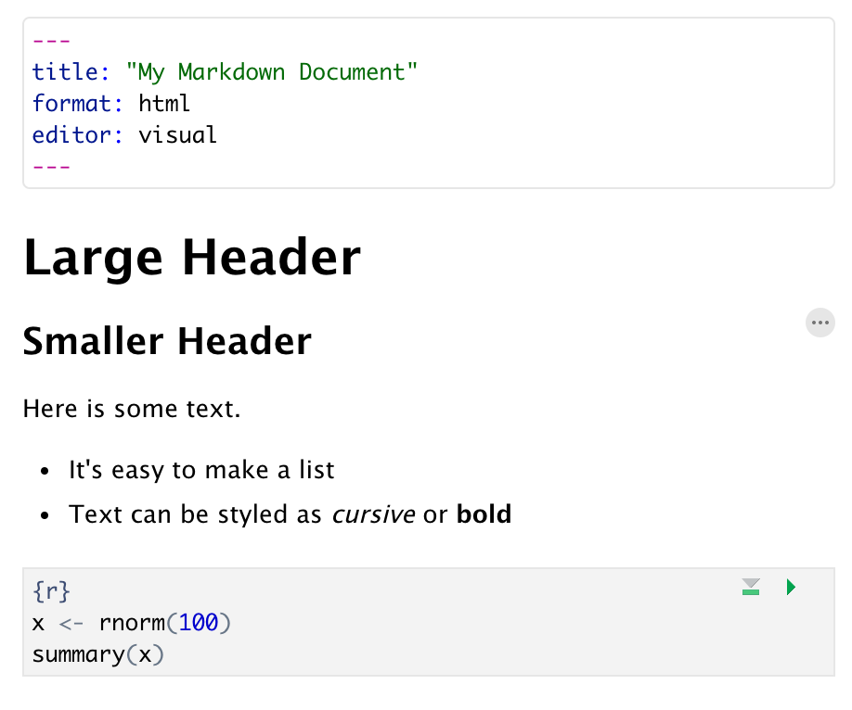
RStudio Terms and Workflow Reminders
Quarto Documents:
Header
Header
Text (w/ formatting)
Code chunk
Notes:
We will be using Quarto Documents for today’s workshop.
Quarto provides a lab notebook interface for analysis, visualization, and annotation of our work.
In Quarto, we can craft computer code mixed in with narrative annotation that documents the purpose of the code and details about the decisions we made in our analysis.
As a reminder, Quarto documents are composed of 3 basic building blocks.
**The first is the Header which includes pieces like the name of the document, the document’s author, and the desired output format when the document is assembled.
**The second block is the text. Quarto documents can be marked in ways that promote readability with various formatting styles.
**Finally, there are code chunks. Code chunks include include R code that can be executed to output results.

Slide 15
RStudio Terms and Workflow Reminders
Functions
object
(stores output)
function
(does stuff)
argument
(input)
data_frame <- read_csv(file_name)
assignment operator
(“gets”)
Notes:
Remember functions in computer programming take inputs and return outputs. But the inputs and outputs here are the arguments and objects that exist within the context of a programming language.
The input that goes into a function is called an argument. The argument to a function gets put in parentheses. A function can have zero, one, or many arguments. If there is more than one argument, we use commas to separate them.
To put the output of the read_csv function into a named object, we use the assignment operator. The assignment operator is a smaller-than followed by a dash or minus and looks kind of like an arrow pointing left. It’s usually read as “gets.”
Together these pieces form the core of the syntax (grammar) of functions in R.

Slide 16
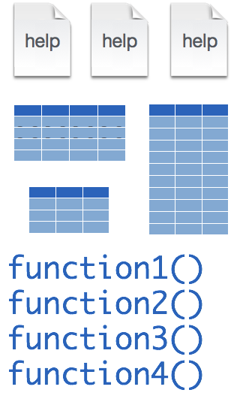
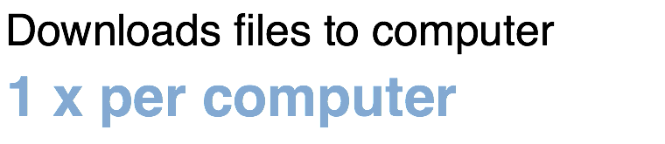
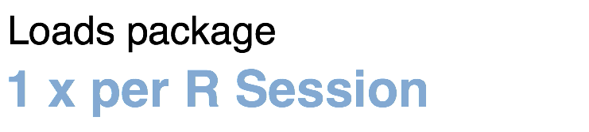
RStudio Terms and Workflow Reminders
Packages:
tidyverse
install.packages("tidyverse")
library("tidyverse")
Notes:
We can extend the functionality of R using packages (collections of functions, data, and help documentation).
Packages need to be installed explicitly – with the command install.packages. So let’s say you want to install a package named “tidyverse”. You go to the R Console and type install.packages(“tidyverse”).
Each package you want to use needs to be installed only once on each computer. However, in order to use the functions or data in the package, you also need to load the package. This is done with the command “library”. So to enable all the functions in the “tidyverse” package, you type library(“tidyverse”). Packages remain loaded until you quit R. So every time you start a new R session you have to load each package that you want to use again.

Slide 17
Your Turn #3
Open 01 – Package Installation.qmd in the exercises folder located in the MISC pane.
Follow the instructions in the Quarto document to install packages needed for this workshop.
Notes:
Now it is your turn to practice open a quarto document, running a code chunk and installing the packages that we will use in today’s workshop.

Slide 18
Orienting to the Data

Slide 19
MIMIC Database
“Medical Information Mart for Intensive Care (MIMIC) is a large, freely-available database comprising deidentified health-related data from patients who were admitted to the critical care units of the Beth Israel Deaconess Medical Center.”
Additional information available at:
https://mimic.mit.edu/
Johnson, A.E.W., Bulgarelli, L., Shen, L. et al. MIMIC-IV, a freely accessible electronic health record dataset. Sci Data 10, 1 (2023). https://doi.org/10.1038/s41597-022-01899-x
Notes:
The MIMIC database is one of the data sets we will be using for today’s workshop (You will also see an example of a non-relational RedCap database in the last session).
MIMIC (Medical Information Mart for Intensive Care) is a very famous medical data set now in its fourth iteration (MIMIC-IV). It is a large, freely-available database comprising deidentified health-related data from patients who were admitted to the critical care units of the Beth Israel Deaconess Medical Center.”
If you would like to learn more about the MIMIC project, please visit their website and refer to the following recent paper:
Johnson, A.E.W., Bulgarelli, L., Shen, L. et al. MIMIC-IV, a freely accessible electronic health record dataset. Sci Data 10, 1 (2023). https://doi.org/10.1038/s41597-022-01899-x

Slide 20
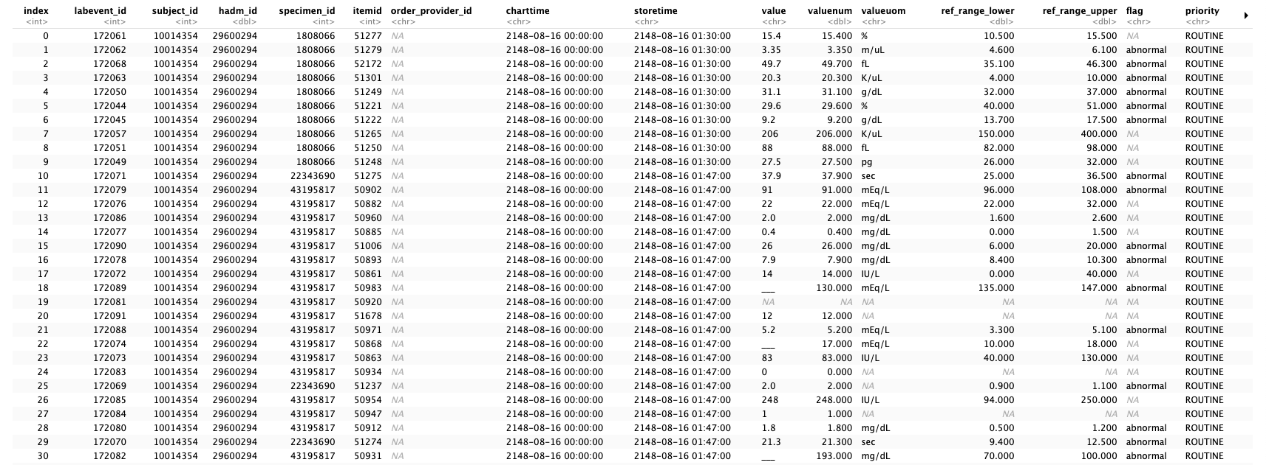
Lab Events Table (labevents)
Notes:
Let’s take a few minutes to orient to some of the key tables we will be referencing in the workshop.
This table is the labevents tables.
What jumps out at you from this table?
-index
-various “id” fields (What table types will likely contain the answer for these ids? [Dimension]
-time stamps (What does that suggest about the type of this particular table? [Fact]
-what about the “NA” entries?

Slide 21
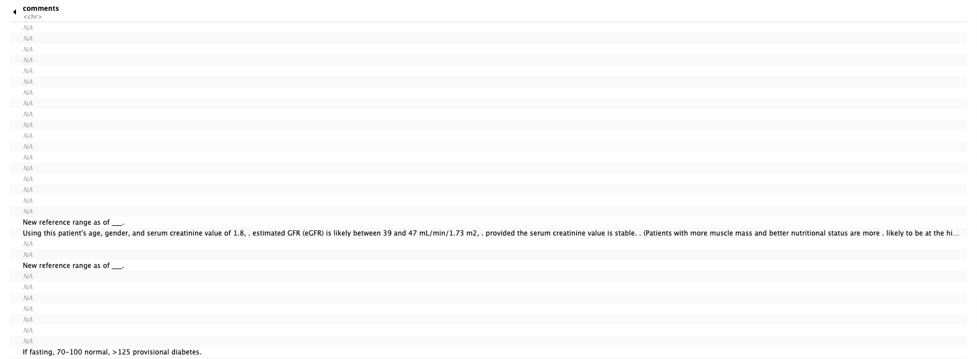
Lab Events Table (labevents) - continued
Notes:
The labevents table is too wide (has too many attributes) to view on a single slide.
The comments table appears to contain free text of various length.

Slide 22
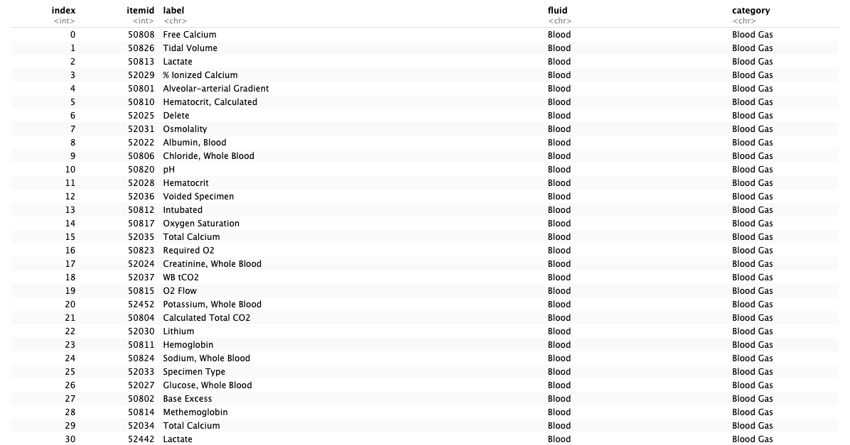
Lab Items (d_labitems)
Notes:
Another table we will reference is the lab items table.
What are the contents of the lab items table?

Slide 23
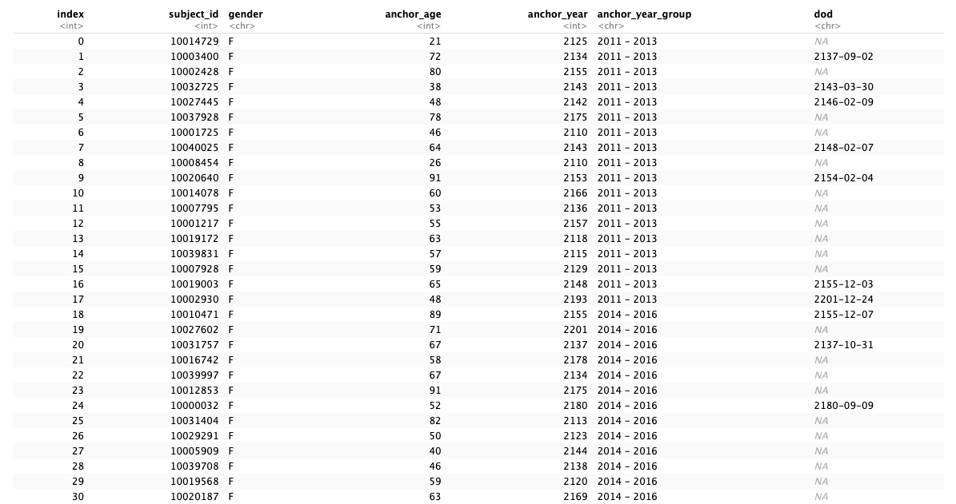
Patients (patients)
Notes:
And the patients table.
Is the patients table more like the lab items table or the labevents table?

Slide 24
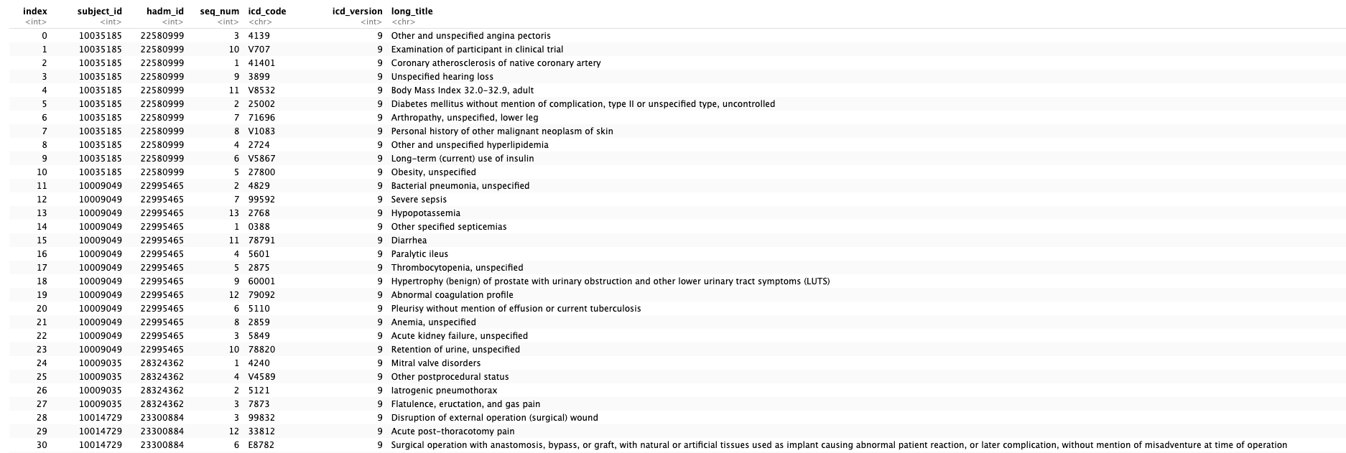
Diagnoses (diagnoses_icd)
Notes:
Finally the diagnoses table.

Slide 25
Your Turn #3
Label the following tables as fact tables or dimension tables:
-Lab Events
-Lab Items
-Patients
-Diagnoses
Notes:
Okay time to reinforce the concept of fact and dimension tables!
Label the four tables we reviewed as fact or dimension.
Answer:
Lab events: Fact
Lab items: Dimension
Patients: Dimension
Diagnoses: Dimension

Slide 26
Querying Databases
Notes:
Now that we have a database, we need a mechanism to solicit data from the tables.
This is called querying.

Slide 27
Structured Query Language (SQL)
The standard query language of the relational database
Clauses are chained to create queries:
SELECT clause chooses the columns to return in a query
FROM clause chooses the table(s) from which the columns are returned
WHERE clause specifies inclusion/exclusion criteria for rows
Notes:
The standard query language for relational databases is Structured Query Language (pronounced “S-Q-L”).
Like R, SQL has its own defined syntax (grammar).
SQL queries are composed of chained clauses which together create queries.
Common clauses include SELECT, FROM and WHERE.

Slide 28
The Lightweight Choice: SQLITE
SQLite is designed to be operated without a separate database management system (i.e. extra software) nor a database administrator
Requires less configuration than many other DB solutions
Stores DB on a single file
Unique approach to access control: access to file determines control (unlike other databases that integrate a separate access - username/password - infrastructure)
Origins of SQLite: https://thenewstack.io/the-origin-story-of-sqlite-the-worlds-most-widely-used-database-software/
Notes:
SQL is available in many variants.
The one we will use today is called SQLite which as the name suggests is a lightweight implementation.
In addition it is open source and simple to deploy.
SQLite has an interesting origin story which you can read about here: https://thenewstack.io/the-origin-story-of-sqlite-the-worlds-most-widely-used-database-software/ .[Richard Hipp providing support for Navy battleships.]

Slide 29
R SQL Translation
Knowing SQL is not necessary for today’s workshop
R will handle the SQL for us
Learning SQL may be helpful for other applications
Notes:
Luckily for us, we don’t need to learn the details of the SQL programming language today.
R will handle the SQL translations for us to talk to the relational database.
Many healthcare databases rely on SQL and learning SQL may be helpful at a future date to unlock data in your own institution.

Slide 30
Recap
Database Systems include the database (data) and database management systems (software for interaction with the database)
Relational databases are the dominant database form and are composed of related tables (rows and columns)
Fact tables carry the transactions and Dimension tables carry the descriptions.
Structured Query Language (SQL) is the standard language for interacting with relational databases. SQL statements are composed of clauses: SELECT, FROM, WHERE.
Medical Information Mart for Intensive Care (MIMIC) is the relational database we will work with in today’s workshop.
Notes:
Here are a few points that summarize this first session.
Database Systems = database + database management system
Relational Databases are the dominant database form.
Relational databases have data in fact tables that can be decoded using dimension tables.
SQL is the standard language for interacting with relational databases.
MIMIC is the relational database we will work with today. And we will also see a non-relational database in the fourth session.

Slide 31
What else?
Notes:
At the end of each lesson we have included a what else section to introduce you to ”what else” you may want to explore and learn about after completing this course.
This includes helpful hints, other functions and exciting packages you may want to check out.

Slide 32
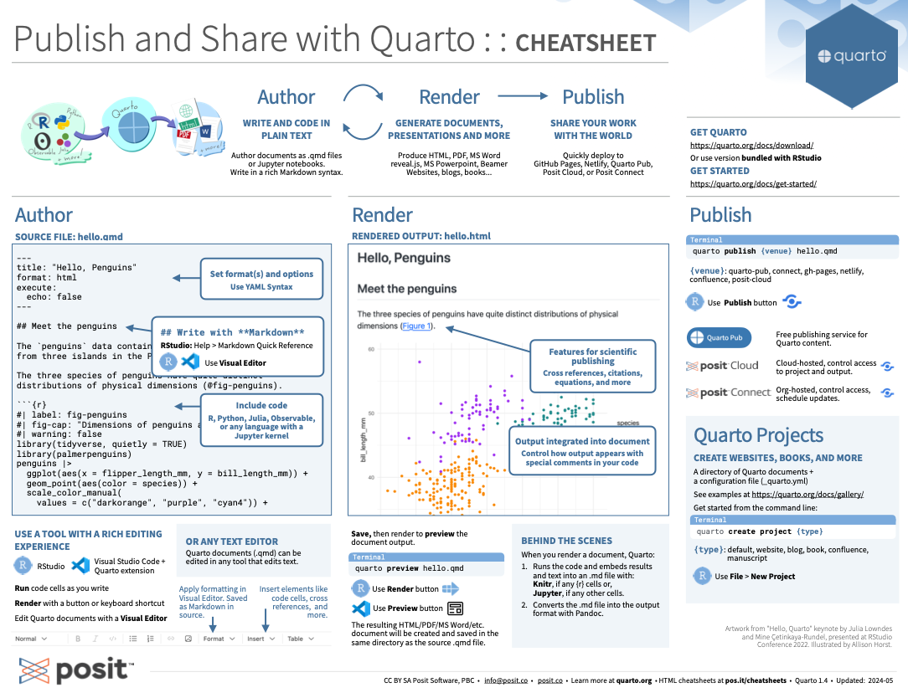
https://posit.co/resources/cheatsheets/
Notes:
Cheat sheets are helpful quick desk references for
Here is a snippet from the Quarto cheat sheet.
Cheat sheets are available for download at: https://posit.co/resources/cheatsheets/

Slide 33
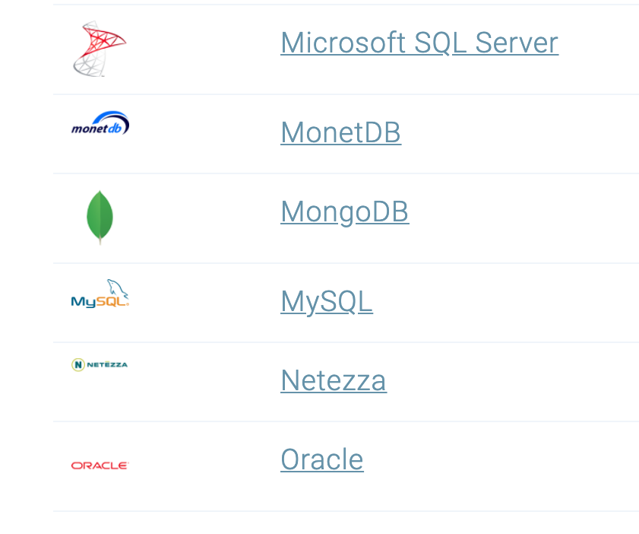
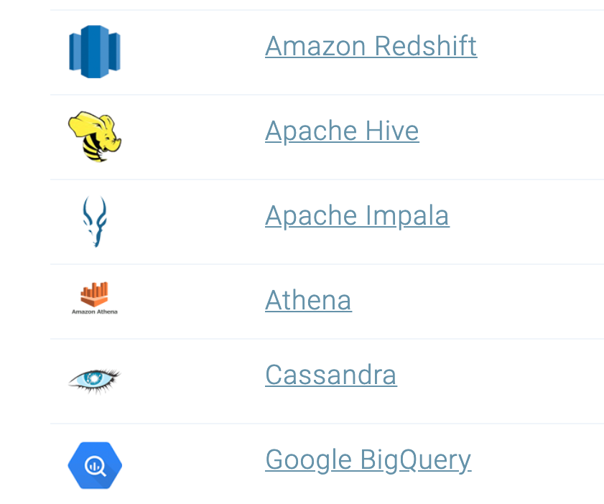
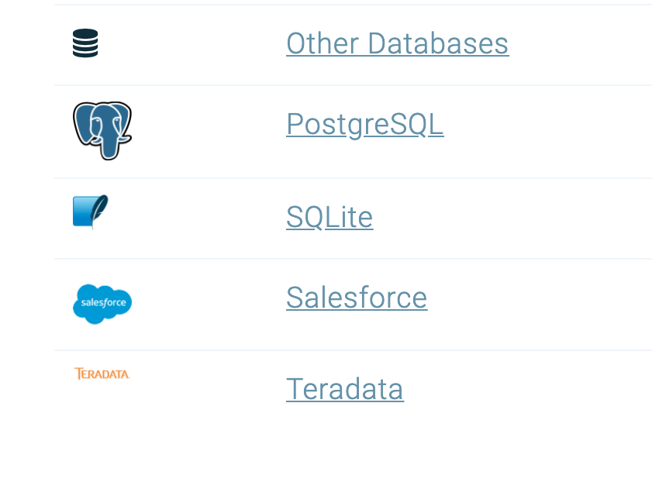
Databases
https://solutions.posit.co/connections/db/databases/
Notes:
You can also connect to a variety of different databases directly in R to source your data.
If you use any of these, you may want to check out the tools to make database connections in R.

